Slide 1
Algorithm Analysis

Slide 2
Types of Analysis
Worst case
Provides an upper bound on running time
An absolute guarantee that the algorithm would not run longer, no matter what the inputs are
Best case
Provides a lower bound on running time
Input is the one for which the algorithm runs the fastest
Average case
Provides a prediction about the running time
Assumes that the input is random

Slide 3
Asymptotic Notation
O notation: asymptotic “less than”:
f(n)=O(g(n)) implies: f(n) “≤” g(n)
Ω notation: asymptotic “greater than”:
f(n)= Ω (g(n)) implies: f(n) “≥” g(n)
Θ notation: asymptotic “equality”:
f(n)= Θ (g(n)) implies: f(n) “=” g(n)

Slide 4
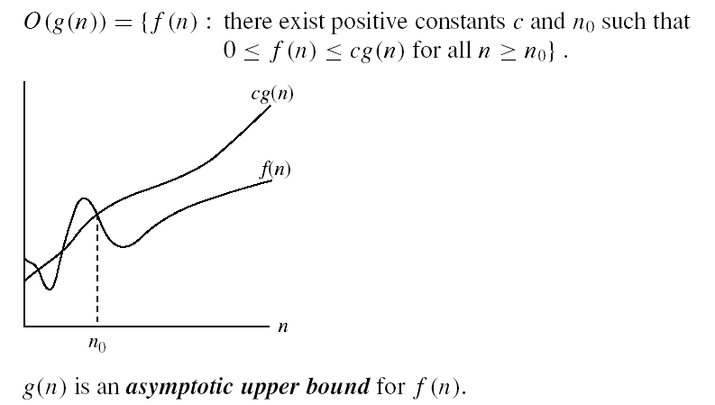
Asymptotic notations
O-notation

Slide 5
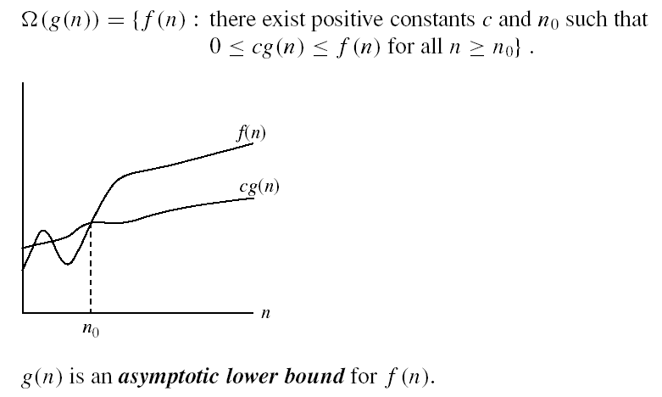
Asymptotic notations (cont.)
Ω - notation
Ω(g(n)) is the set of functions with larger or same order of growth as g(n)

Slide 6

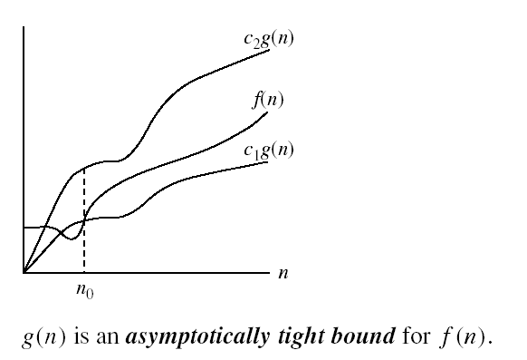
Asymptotic notations (cont.)
Θ-notation
Θ(g(n)) is the set of functions with the same order of growth as g(n)

Slide 7
Basic asymptotic efficiency classes
1 | constant
log n | logarithmic
n | linear
n log n | n-log-n
n² | quadratic
n³ | cubic
2^{n} | exponential
n! | factorial

Slide 8
What is f(n)
How to find it
Two Types of algorithm
Iterative
No of time loop executes
Recursion
Backward Substitution
NOTE: CONSTANT O(1)

Slide 9
Function(){
int I;
for(i=1 to n)
print(“Hello”);
}
}

Slide 10
function(){
int i=1, s=1;
while(S<=n)
{
i++;
s=s+i;
printf(“hello”)
}
}
S
i

Slide 11
function(){
int i=1, s=1;
while(S<=n)
{
i++;
s=s+i;
printf(“hello”)
}
}
S
i 1

Slide 12
function(){
int i=1, s=1;
while(S<=n)
{
i++;
s=s+i;
printf(“hello”)
}
}
S 1
i 1

Slide 13
function(){
int i=1, s=1;
while(S<=n)
{
i++;
s=s+i;
printf(“hello”)
}
}
S 1
i 1 2

Slide 14
function(){
int i=1, s=1;
while(S<=n)
{
i++;
s=s+i;
printf(“hello”)
}
}
S 1 3
i 1 2

Slide 15
function(){
int i=1, s=1;
while(S<=n)
{
i++;
s=s+i;
printf(“hello”)
}
}
S 1 3
i 1 2 3

Slide 16
function(){
int i=1, s=1;
while(S<=n)
{
i++;
s=s+i;
printf(“hello”)
}
}
S 1 3 6
i 1 2 3

Slide 17
function(){
int i=1, s=1;
while(S<=n)
{
i++;
s=s+i;
printf(“hello”)
}
}
S 1 3 6
i 1 2 3 4

Slide 18
function(){
int i=1, s=1;
while(S<=n)
{
i++;
s=s+i;
printf(“hello”)
}
}
S 1 3 6 10
i 1 2 3 4

Slide 19
function(){
int i=1, s=1;
while(S<=n)
{
i++;
s=s+i;
printf(“hello”)
}
}
S 1 3 6 10
i 1 2 3 4 5

Slide 20
function(){
int i=1, s=1;
while(S<=n)
{
i++;
s=s+i;
printf(“hello”)
}
}
S 1 3 6 10 15
i 1 2 3 4 5

Slide 21
function(){
int i=1, s=1;
while(S<=n)
{
i++;
s=s+i;
printf(“hello”)
}
}
S 1 3 6 10 15
i 1 2 3 4 5 6

Slide 22
function(){
int i=1, s=1;
while(S<=n)
{
i++;
s=s+i;
printf(“hello”)
}
}
S 1 3 6 10 15 21
i 1 2 3 4 5 6

Slide 23
function(){
int i=1, s=1;
while(S<=n)
{
i++;
s=s+i;
printf(“hello”)
}
}
S 1 3 6 10 15 21
i 1 2 3 4 5 6.........n

Slide 24
function(){
int i=1, s=1;
while(S<=n)
{
i++;
s=s+i;
printf(“hello”)
}
}
S 1 3 6 10 15 21……k(k+1)/2
i 1 2 3 4 5 6.........n

Slide 25

function(){
int i=1, s=1;
while(S<=n)
{
i++;
s=s+i;
printf(“hello”)
}
}
S 1 3 6 10 15 21……k(k+1)/2
i 1 2 3 4 5 6.........k
K(K+1)/2 >=n
(K2+k)/2>=n
Which means $K^{2}=n$
k =$\sqrt{n}$ ie O($\sqrt{n}$)

Slide 26

Function(){
i=1;
for(i=1;i(squr)<=n;i++
printf(“hello”);
}
$$i^{2}≤n$$
or$i= \sqrt{n}$

Slide 27
Function(){
int I,j,k,n;
for(i=1;i<=n;i++){
for(j=1;j<=i;j++){
for(k=1;k<=100;k++){
print(“Hello”);
}
}
}
}
I
J
K

Slide 28
Function(){
int I,j,k,n;
for(i=1;i<=n;i++){
for(j=1;j<=i;j++){
for(k=1;k<=100;k++){
print(“Hello”);
}
}
}
}
I 1 2 3 4 5…………….n
J 1 2 3 4 5…………….n
K 1*100 2*100 3*100 4*100 5*100…….n
1*100+2*100+3*100+4*100+……n*100
100(1+2+3+4+……………n)
n(n+1)/2 ie O(n2)

Slide 29

Function(){
int I,j,k,n;
for(i=1;i<=n;i++){
for(j=1;j<= $i^{2}$;j++){
for(k=1;k<=n/2;k++){
printf(“Hello”);
}
}
}
}
i
J
K

Slide 30

Function(){
int I,j,k,n;
for(i=1;i<=n;i++){
for(j=1;j<= $i^{2}$;j++){
for(k=1;k<=n/2;k++){
printf(“Hello”);
}
}
}
}
I 1 2 3 4 5…………………….n
J 1 4 9 16 25………………….. $n^{2}$
K 1*n/2 4*n/2 9*n/2 16*n/2 25*n/2…………..$n^{2}$*n/2
1*n/2 4*n/2 9*n/2 16*n/2 25*n/2…………..n2*n/2
n/2(1+$1^{2}+2^{2}+3^{2}$+….. $n^{2}$)
n/2[(n(n+1)(2n+1)/6]

Slide 31

Function(){
for(i=1;i<n;i=i*2)
printf(“hello”);
}
i=1 2 4 8 16 n
$2^{0}$ $2^{1}$ $2^{2}$ $2^{3}$ $2^{4}$ $2^{k}$
$2^{k}$=n
K=log(n)

Slide 32
Function(){
int i,j,k;
for(i=n/2;i<=n;i++)
for(j=1;j<=n/2;j++)
for(k=1;k<=n;k=k*2)
printf(“hello”);
}

Slide 33
Function(){
int I,j,k;
for(i=n/2;i<=n;i++)
for(j=1;j<=n;j=2*j)
for(k=1;k<=n;k=k*2)
printf(“Hello”);
}

Slide 34
Function(){
for(i=1;i<=n,i++)
for(j=I;j<=n;j=j+i)
printf(“hello”);
}
I
J

Slide 35
Function(){
for(i=1;i<=n,i++)
for(j=I;j<=n;j=j+i)
printf(“hello”);
}
i=1 2 3 4 …… n
J=n n/2 n/3 n/4……. n/n
n+n/2+N/3+……1/n)
n(1+1/2+1/3+1/4+……..1/n)
n(logn)

Slide 36
Function(n){
if(n>1)
return(function(n-1))
}

Slide 37
Function(n){
if(n>1) T(1)
return(function(n-1))
}

Slide 38
Function(n){
if(n>1) T(1)
return(function(n-1)) T(n-1)
}

Slide 39
Function(n){
if(n>1) T(1)
return(function(n-1)) T(n-1)
}
T(n)=1+T(n-1) eq(1)

Slide 40
Function(n){
if(n>1) T(1)
return(function(n-1)) T(n-1)
}
T(n)=1+T(n-1) eq(1)
To find T(n-1) substitute n-1 to all n in eq(1)

Slide 41
Function(n){
if(n>1) T(1)
return(function(n-1)) T(n-1)
}
T(n)=1+T(n-1) eq(1)
To find T(n-1) substitute n-1 to all n in eq(1)
T(n-1)=1+T(n-2) eq(2)

Slide 42
Function(n){
if(n>1) T(1)
return(function(n-1)) T(n-1)
}
T(n)=1+T(n-1) eq(1)
To find T(n-1) substitute n-1 to all n in eq(1)
T(n-1)=1+T(n-2) eq(2)
To find T(n-2) substitute n-2 to all n in eq(1)

Slide 43
Function(n){
if(n>1) T(1)
return(function(n-1)) T(n-1)
}
T(n)=1+T(n-1) eq(1)
To find T(n-1) substitute n-1 to all n in eq(1)
T(n-1)=1+T(n-2) eq(2)
To find T(n-2) substitute n-2 to all n in eq(1)
T(n-2)=1+T(n-3) eq(3)

Slide 44
Function(n){
if(n>1) T(1)
return(function(n-1)) T(n-1)
}
T(n)=1+T(n-1) eq(1)
To find T(n-1) substitute n-1 to all n in eq(1)
T(n-1)=1+T(n-2) eq(2)
To find T(n-2) substitute n-2 to all n in eq(1)
T(n-2)=1+T(n-3) eq(3)
Backward substitution

Slide 45
Function(n){
if(n>1) T(1)
return(function(n-1)) T(n-1)
}
T(n)=1+T(n-1) eq(1)
To find T(n-1) substitute n-1 to all n in eq(1)
T(n-1)=1+T(n-2) eq(2)
To find T(n-2) substitute n-2 to all n in eq(1)
T(n-2)=1+T(n-3) eq(3)
Backward substitution
Substitute eq(2) in 1 T(n) = I+[1+T[n-2]] = 2+T[n-2]

Slide 46
Function(n){
if(n>1) T(1)
return(function(n-1)) T(n-1)
}
T(n)=1+T(n-1) eq(1)
To find T(n-1) substitute n-1 to all n in eq(1)
T(n-1)=1+T(n-2) eq(2)
To find T(n-2) substitute n-2 to all n in eq(1)
T(n-2)=1+T(n-3) eq(3)
Backward substitution
Substitute eq(2) in 1 T(n) = I+[1+T[n-2]] = 2+T[n-2]
Substitute eq(3) in 4 T(n)=2+[1+T[n-3]] = 3+T[n-3]

Slide 47
Function(n){
if(n>1) T(1)
return(function(n-1)) T(n-1)
}
T(n)=1+T(n-1) eq(1)
To find T(n-1) substitute n-1 to all n in eq(1)
T(n-1)=1+T(n-2) eq(2)
To find T(n-2) substitute n-2 to all n in eq(1)
T(n-2)=1+T(n-3) eq(3)
Backward substitution
Substitute eq(2) in 1 T(n) = I+[1+T[n-2]] = 2+T[n-2]
Substitute eq(3) in 2 T(n)=2+[1+T[n-3]] = 3+T[n-3]
K+T[n-k] eq(4)

Slide 48
Function(n){
if(n>1) T(1)
return(function(n-1)) T(n-1)
}
T(n)=1+T(n-1) eq(1)
To find T(n-1) substitute n-1 to all n in eq(1)
T(n-1)=1+T(n-2) eq(2)
To find T(n-2) substitute n-2 to all n in eq(1)
T(n-2)=1+T(n-3) eq(3)
Backward substitution
Substitute eq(2) in 1 T(n) = I+[1+T[n-2]] = 2+T[n-2]
Substitute eq(3) in 2 T(n)=2+[1+T[n-3]] = 3+T[n-3]
K+T[n-k] eq(4)
When n-k=1 loop stop so k=n-1 substitute in eq(4)

Slide 49
Function(n){
if(n>1) T(1)
return(function(n-1)) T(n-1)
}
T(n)=1+T(n-1) eq(1)
To find T(n-1) substitute n-1 to all n in eq(1)
T(n-1)=1+T(n-2) eq(2)
To find T(n-2) substitute n-2 to all n in eq(1)
T(n-2)=1+T(n-3) eq(3)
Backward substitution
Substitute eq(2) in 1 T(n) = I+[1+T[n-2]] = 2+T[n-2]
Substitute eq(3) in 2 T(n)=2+[1+T[n-3]] = 3+T[n-3]
K+T[n-k]
When n-k=1 loop stop so k=n-1 substitute in eq(4)
n-1+T[n-[n-1]]]

Slide 50
Function(n){
if(n>1) T(1)
return(function(n-1)) T(n-1)
}
T(n)=1+T(n-1) eq(1)
To find T(n-1) substitute n-1 to all n in eq(1)
T(n-1)=1+T(n-2) eq(2)
To find T(n-2) substitute n-2 to all n in eq(1)
T(n-2)=1+T(n-3) eq(3)
Backward substitution
Substitute eq(2) in 1 T(n) = I+[1+T[n-2]] = 2+T[n-2]
Substitute eq(3) in 2 T(n)=2+[1+T[n-3]] = 3+T[n-3]
K+T[n-k]
When n-k=1 loop stop so k=n-1 substitute in eq(4)
n-1+T[n-[n-1]]]
n

Slide 51
Function(n){
if(n>1) T(1)
return(function(n-1)) T(n-1)
}
T(n)=1+T(n-1) eq(1)
To find T(n-1) substitute n-1 to all n in eq(1)
T(n-1)=1+T(n-2) eq(2)
To find T(n-2) substitute n-2 to all n in eq(1)
T(n-2)=1+T(n-3) eq(3)
Backward substitution
Substitute eq(2) in 1 T(n) = I+[1+T[n-2]] = 2+T[n-2]
Substitute eq(3) in 2 T(n)=2+[1+T[n-3]] = 3+T[n-3]
K+T[n-k]
When n-k=1 loop stop so k=n-1 substitute in eq(4)
n-1+T[n-[n-1]]]
n
O(n)

Slide 52
Algorithms for computing the Factorial
int factorial (int n)
{
if (n<=1)
return 1;
else {
fact = 1;
for (k=2; k<=n; k++)
fact =fact* k;
return fact;
}
}
int factorial (int n)
{
If (n <= 1)
return 1;
else
return n * factorial(n-1);
}

Slide 53
int sum(int n)
{
if (n != 0)
return n + addNumbers(n - 1);
else return n;
}

Slide 54
T(n)=n+T(n-1)

Slide 55
Master Theorem
Let T(n) be a monotonically increasing function that satisfies
T(n) = a T(n/b) + f(n)
T(1) = c
where a ≥ 1, b ≥ 2, c>0. If f(n) is Θ(n^{d}) where d ≥ 0 then
 |  | if a < b^{d}
T(n) = |  | If a = b^{d}
 |  | if a > b^{d}

Slide 56
Review: Analysis of Merge Sort
Statement Effort
So T(n) = Θ(1) when n = 1, and 2T(n/2) + Θ(n) when n > 1
This expression is a recurrence
MergeSort(A, left, right) { T(n)
if (left < right) { Θ(1)
mid = floor((left + right) / 2); Θ(1)
MergeSort(A, left, mid); T(n/2)
MergeSort(A, mid+1, right); T(n/2)
Merge(A, left, mid, right); Θ(n)
}
}

Slide 57
Master Theorem: Example 1
Let T(n) = T(n/2) + ½ n² + n. What are the parameters?
a =
b =
d =
Therefore, which condition applies?
1
T(n) = a T(n/b) + f(n)
2
2
1 < 2², case 1 applies
We conclude that
T(n) ∈ Θ(n^{d}) = Θ (n²)

Slide 58
Master Theorem: Example 2
Let T(n)= 2 T(n/4) + √n + 42. What are the parameters?
a =
b =
d =
Therefore, which condition applies?
2
4
1/2
2 = 4^{1/2}, case 2 applies
We conclude that

Slide 59
Master Theorem: Example 3
Let T(n)= 3 T(n/2) + 3/4n + 1. What are the parameters?
a =
b =
d =
Therefore, which condition applies?
3
2
1
3 > 2¹, case 3 applies
We conclude that

